Slide 1

REDDIT COMMENT ANALYSIS
CIS5200:03 |
Project Group 4
Guided By: Prof Jongwook Woo | Submitted By: YASH CHOKSI SWETA TRIPATHI SOWMYA MAREEDU SINDHURA VEMURI KAROLINa stachurska

Slide 2
INTRODUCTION
Large number of readers
Shapes public opinion
Outlook on current affairs
Sets the tone of the public discourse
Comments sections give insights to readers’ opinions on the subject matter of the articles

Slide 3

GOALS
Analyzing popular content of REDDIT inorder to find more user activity.
Analyzing controversiality in comments.
Analyzing the more user activity in REDDIT at high level.

Slide 4
ABOUT DATASET
Dataset URL : https://www.kaggle.com/reddit/reddit-comments-may-2015
Comments, Articles | MAY 2015
DATA COLOUMS: Author, Created_Utc, Subreddit, Distinguished, Controversiality and more.
Dataset Size: 16 GB

Slide 5
TECHNICAL SPECIFICATON
Cluster version: Hadoop 2.8.5-amzn-4
Cluster number of nodes: 3 nodes
Memory size(CPU speed): 2.20 GHz
HDFS Capacity: 147 GB
Storage: 678 GB
Hive Version: Hive 2.3.5-amzn-1

Slide 6

FLOW CHART

Slide 7

DATASET SOURCE
DOWNLOAD CSV FILES
VISUALIZE
DATA CLEANING
STORE AND PROCESS DATA
QUERY

Slide 8
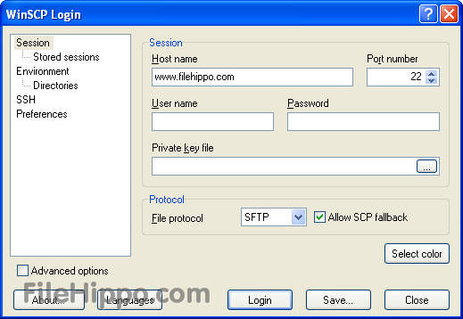
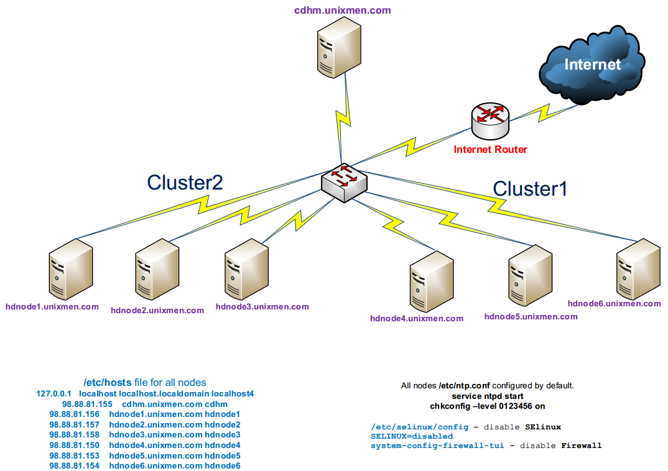



ARCHITECTURE
wget https://raw.githubusercontent.com/shradhacsula/Data-Project/master/ArticleYear2017.txt
wget https://raw.githubusercontent.com/shradhacsula/Data-Project/master/ArticleYear2018.txt
EMR
ssh smareed@34.221.40.43
ssh smareed@129.150.71.75

Slide 9
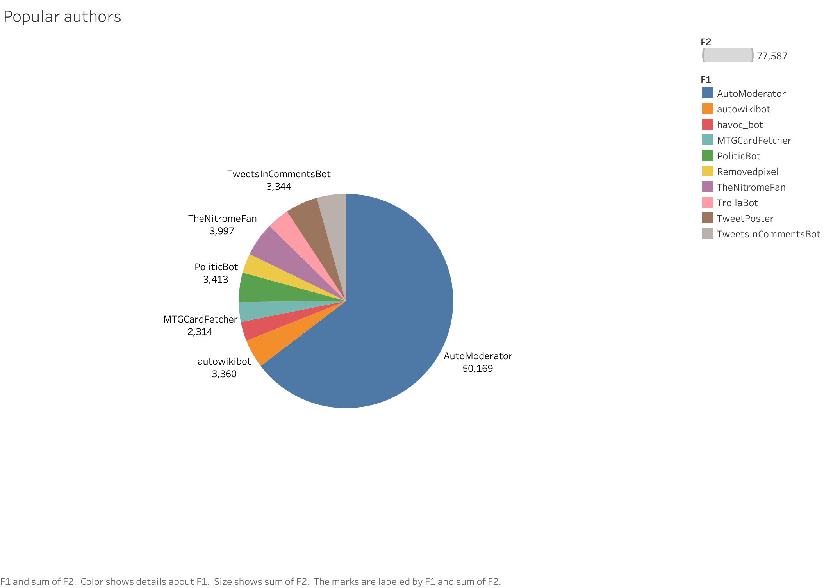
AUTHORS

Slide 10
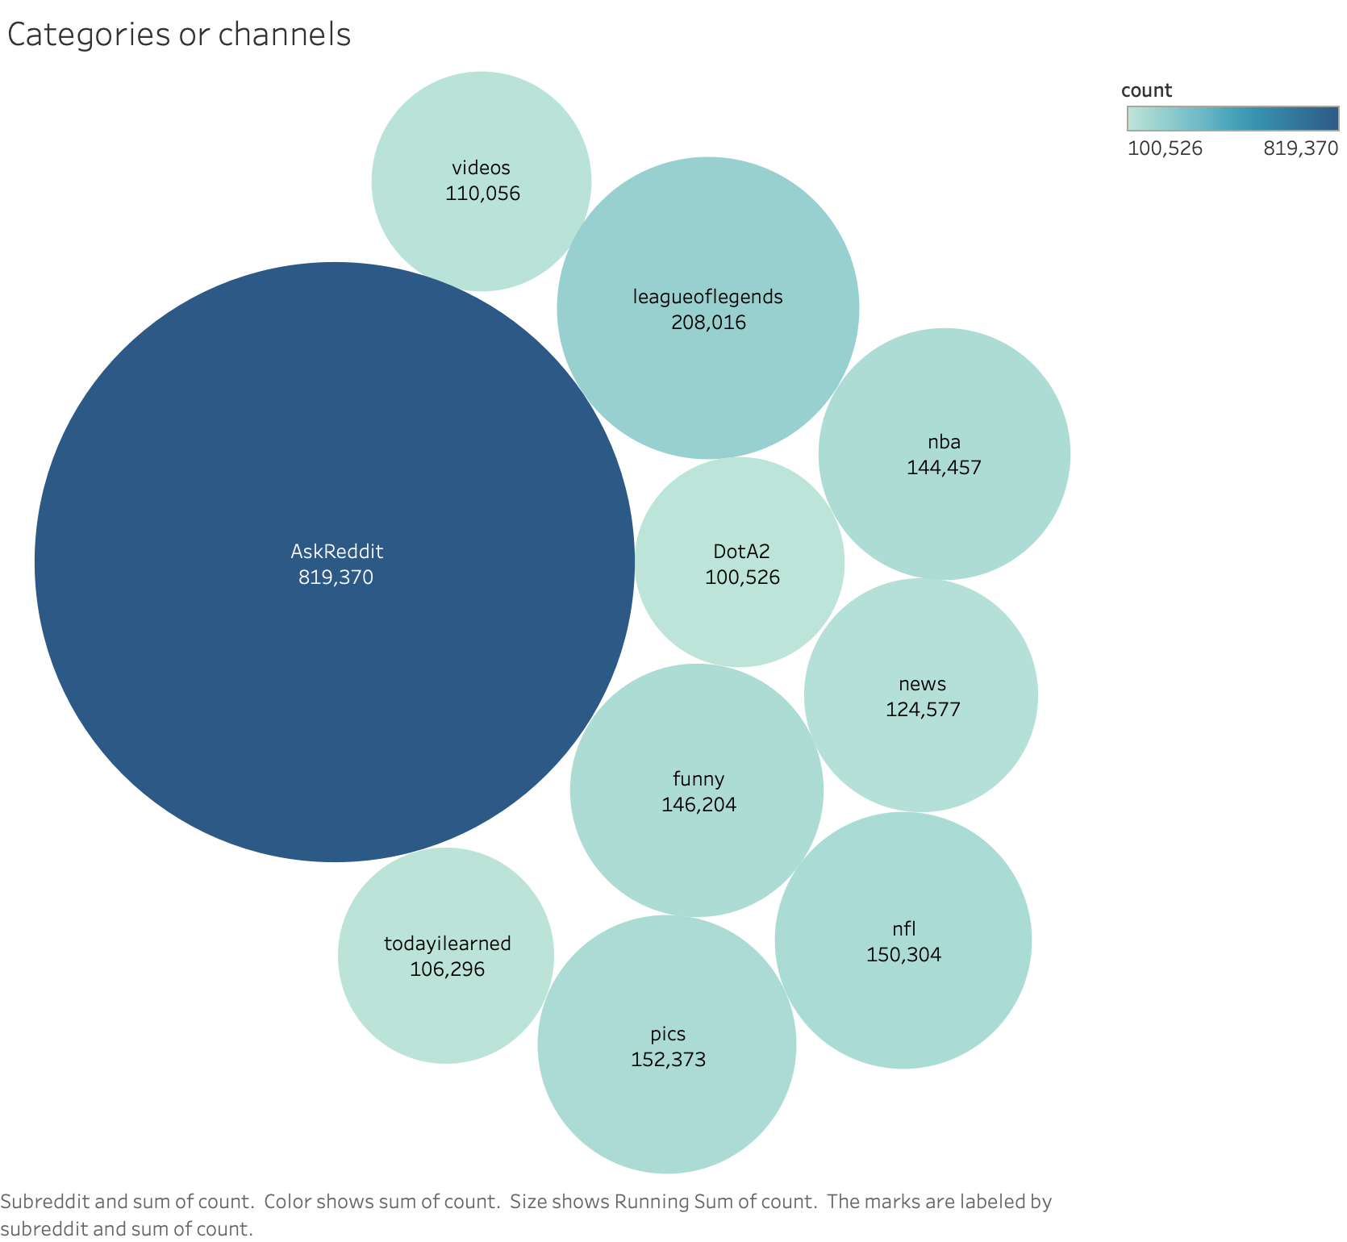
channels

Slide 11
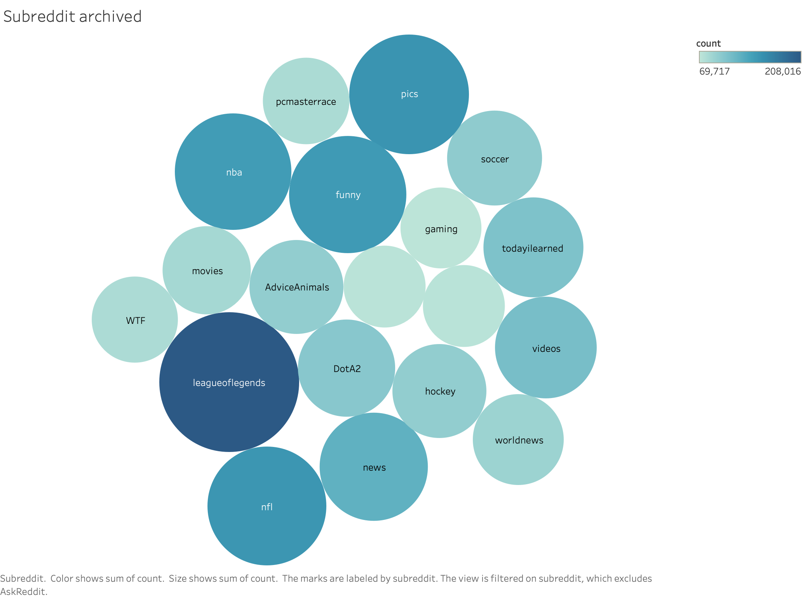
SUBREDDIT

Slide 12
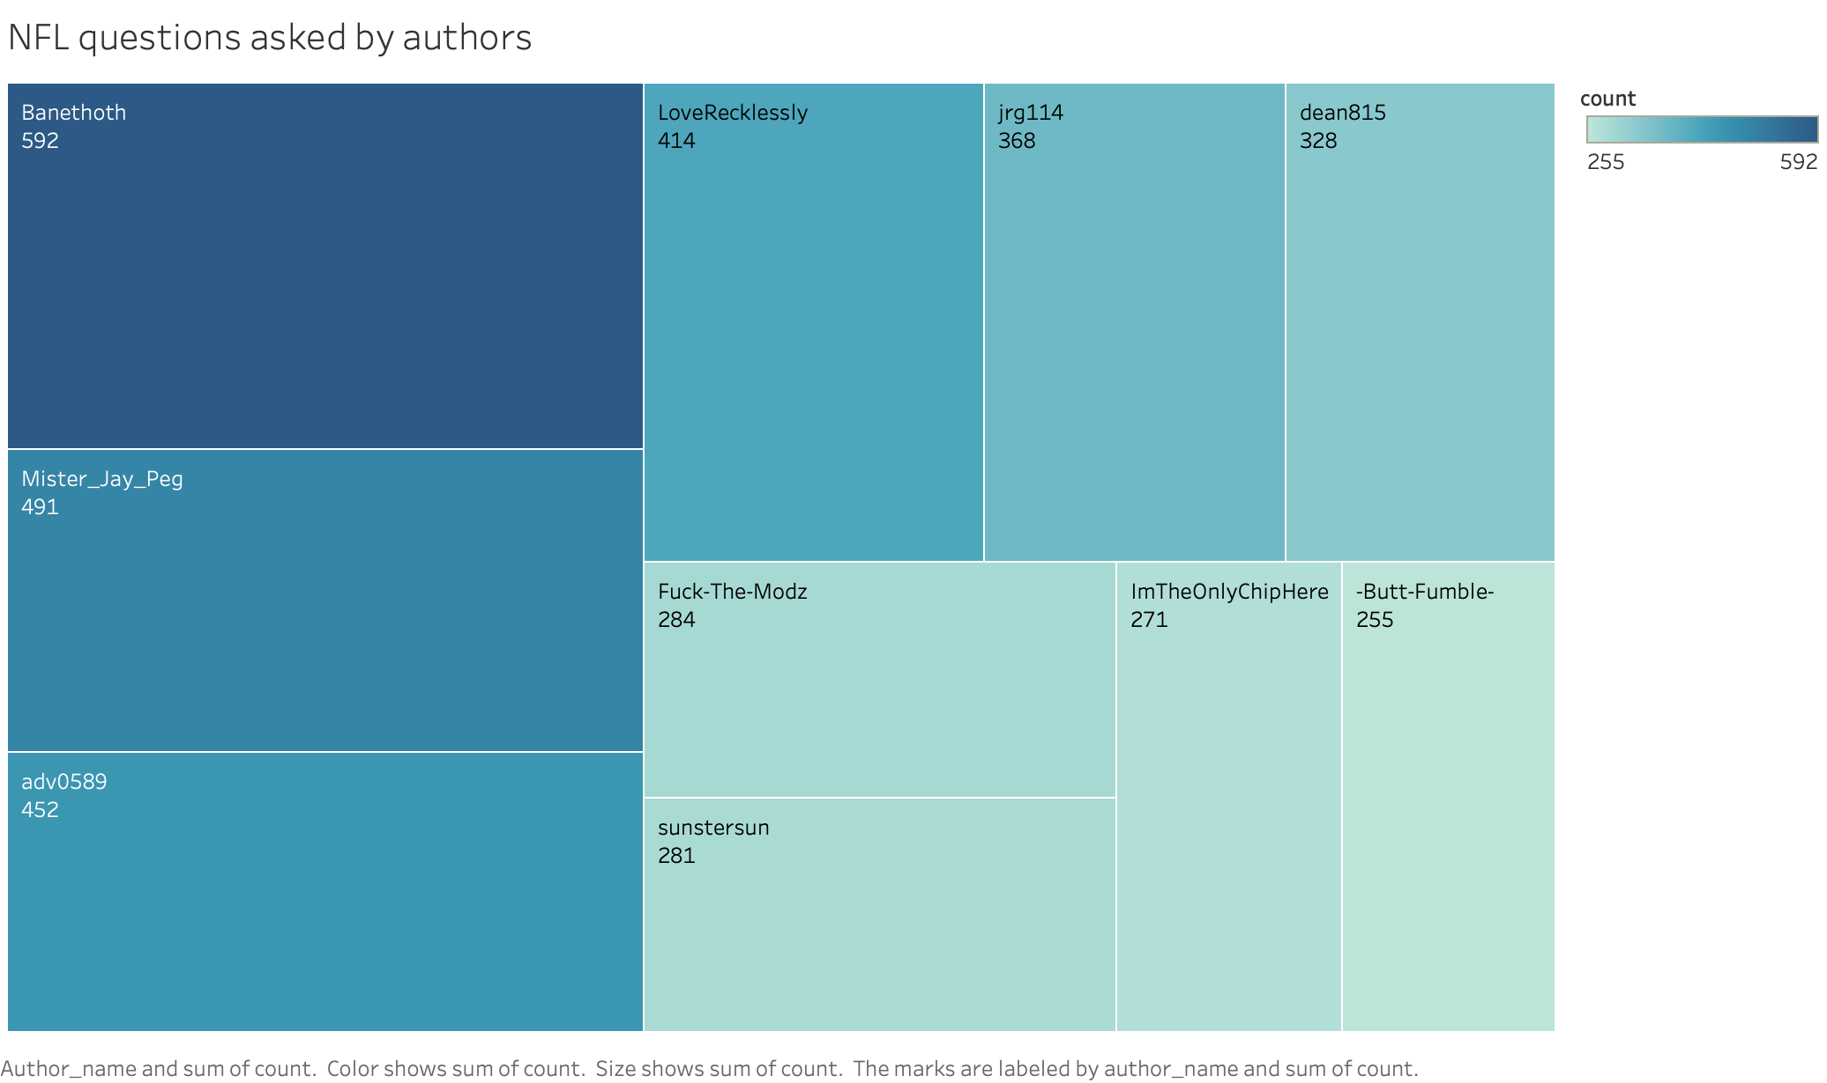
AUTHORS WHO ASKED QUESTIONS ABOUT NFL

Slide 13
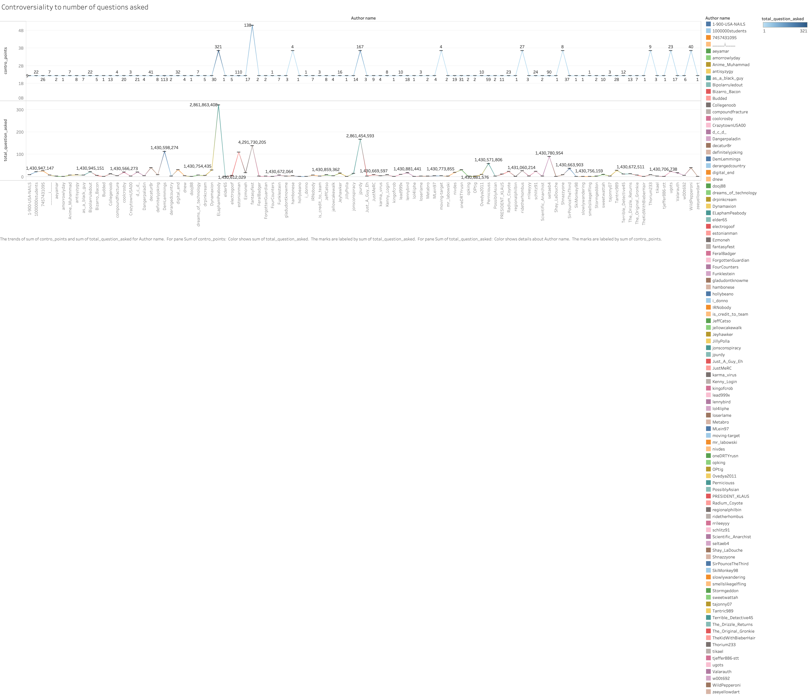
CONTROVERSIALITY TO NUMBER OF QUESTIONS ASKED

Slide 14
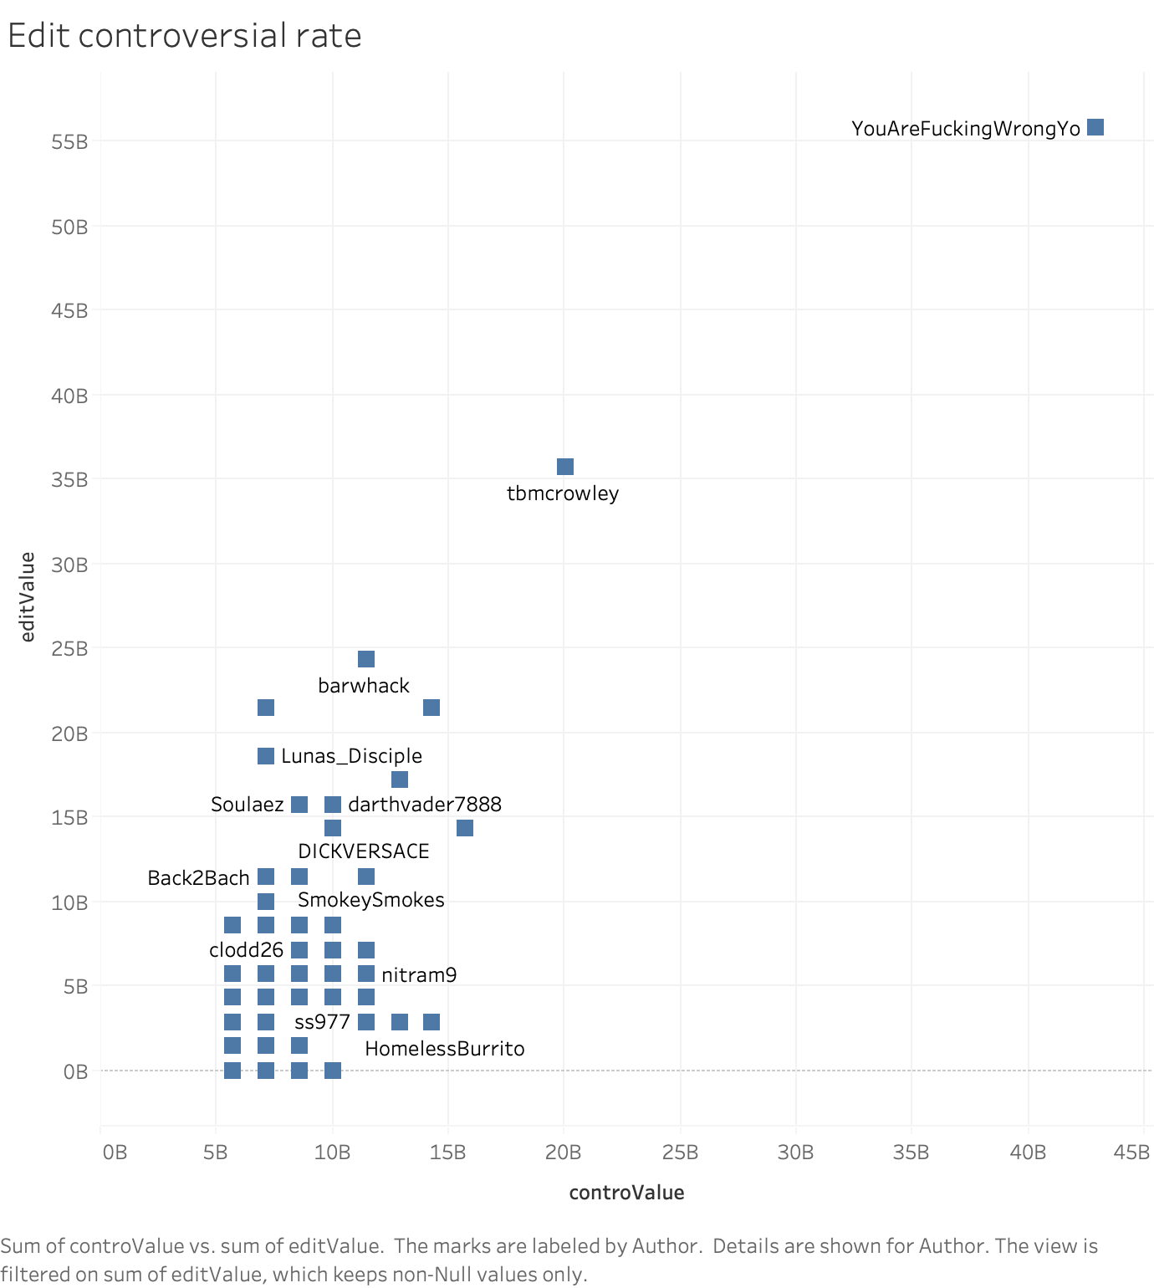
CONTROVERSIAL RATE

Slide 15
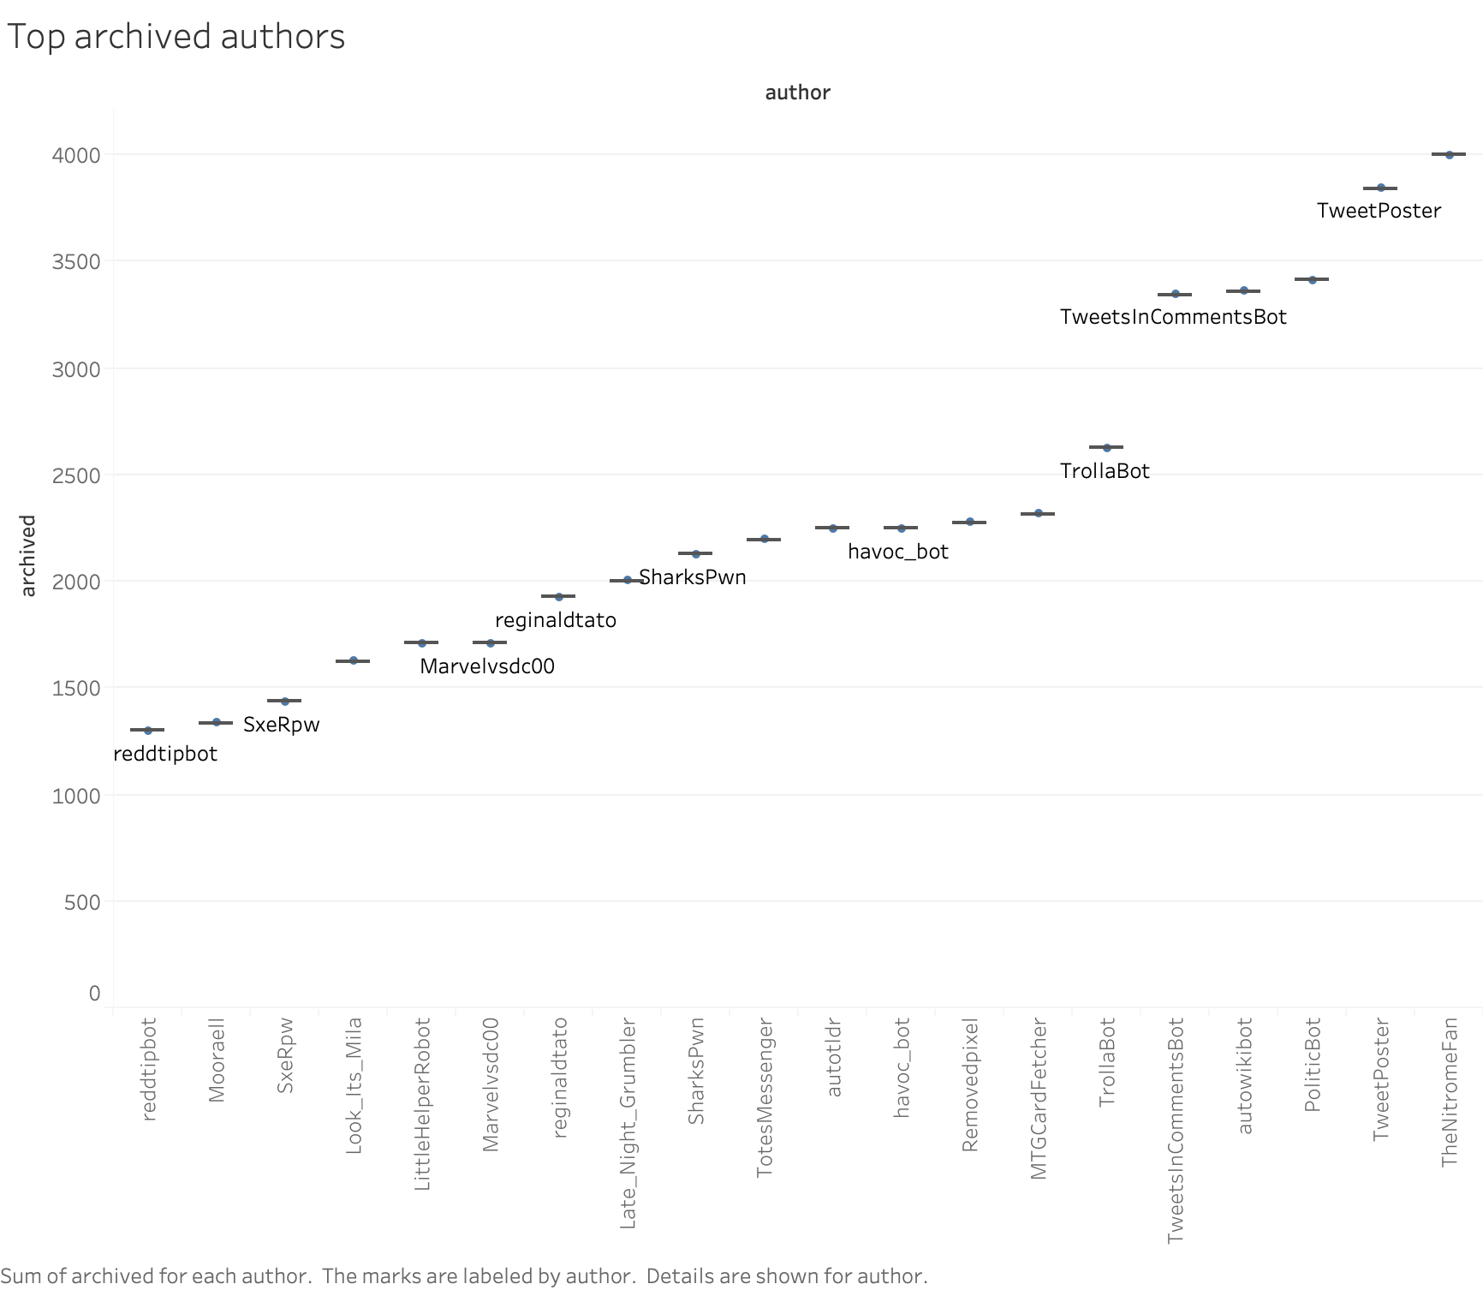
TOP ARCHIVED AUTHORS

Slide 16
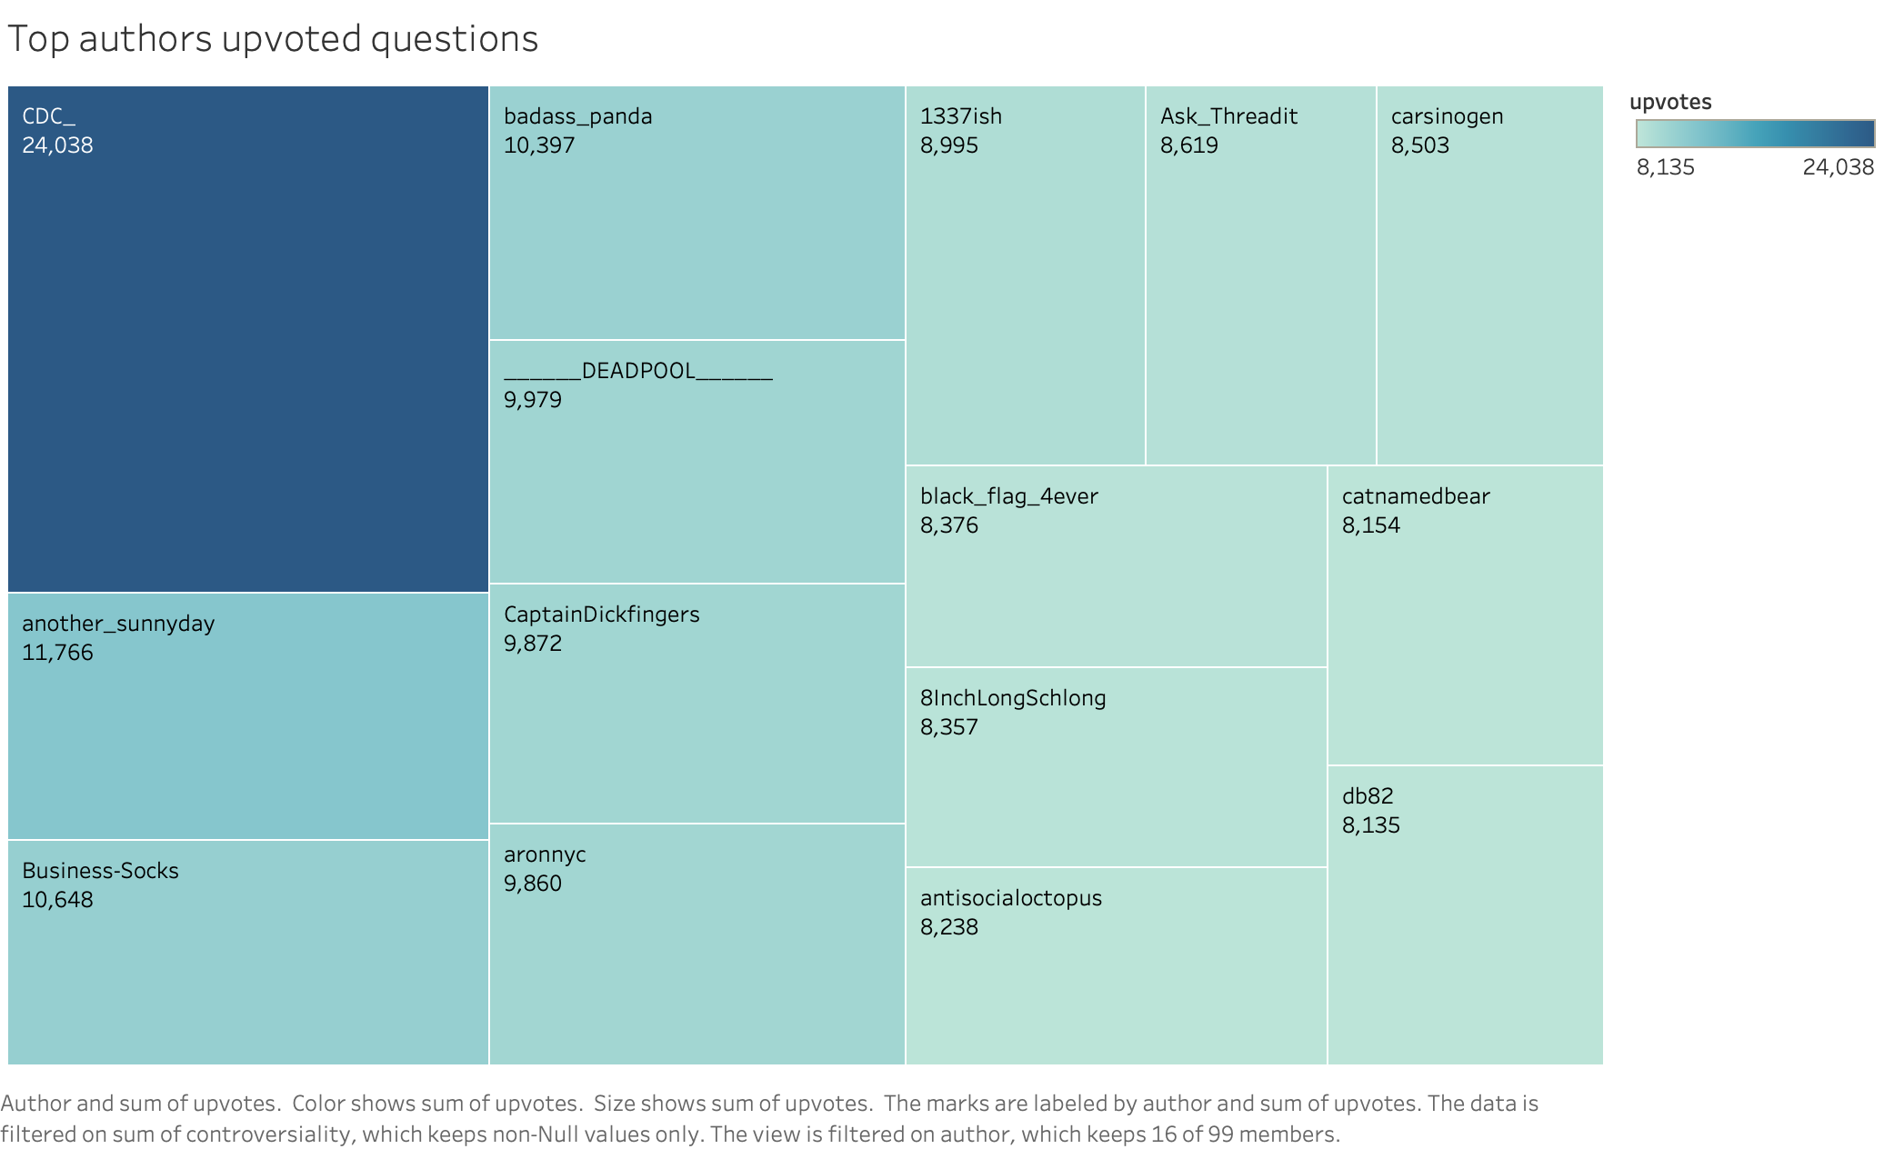
TOP AUTHORS UPVOTED QUESTIONS

Slide 17
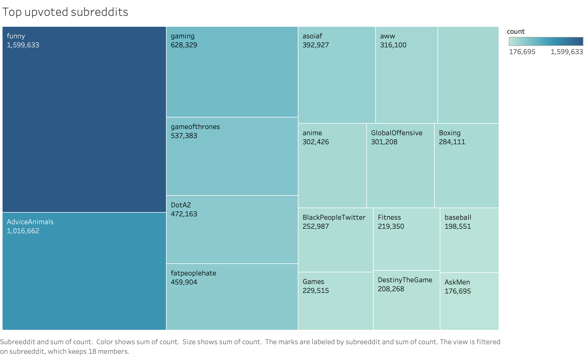
TOP UPVOTED SUBREDDITS

Slide 18

https://github.com/yashchks87/Reddit_comments.git

Slide 19
CONCLUSION
Famous content in REDDIT
Controversiality in comments
Most popular authors, popular channels and controversial topics
Sentiments
Number of posting does not depends upon controversy

Slide 20

QUESTIONS

Slide 21

Thank You

